Slide 1
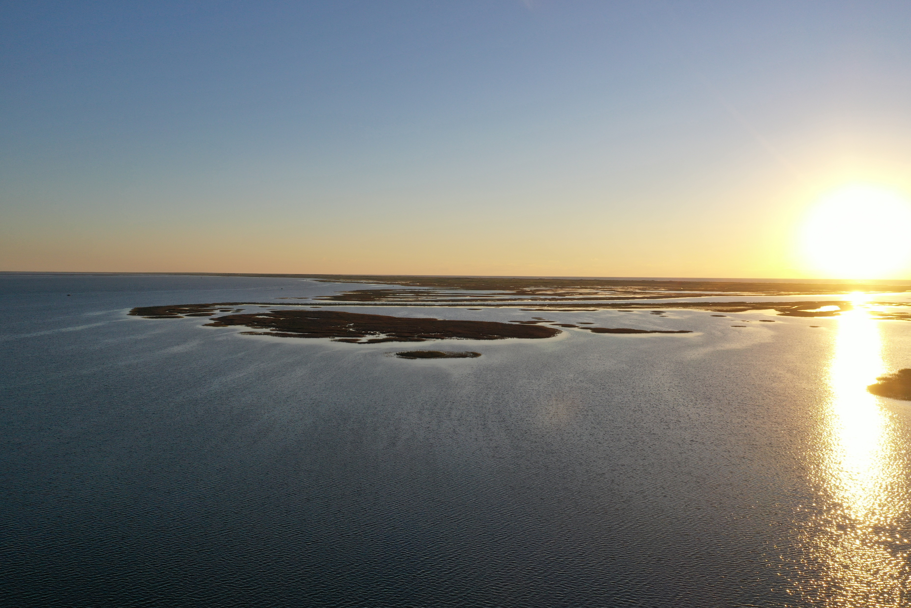
Creating a Geospatial Map of Light Attenuation
from Suspended Sediment Plumes
Laura Ramirez
Notes:
Creating a Geospatial Map of Light Attenuation from Suspended Sediment Plumes

Slide 2
OVERVIEW
Importance of seagrass
Sediment Plumes and their effects
CMP Final Report - Previous data analysis of light logger capture
Steps for data collection and manipulation
Heatmap
Future research perspectives

Slide 3
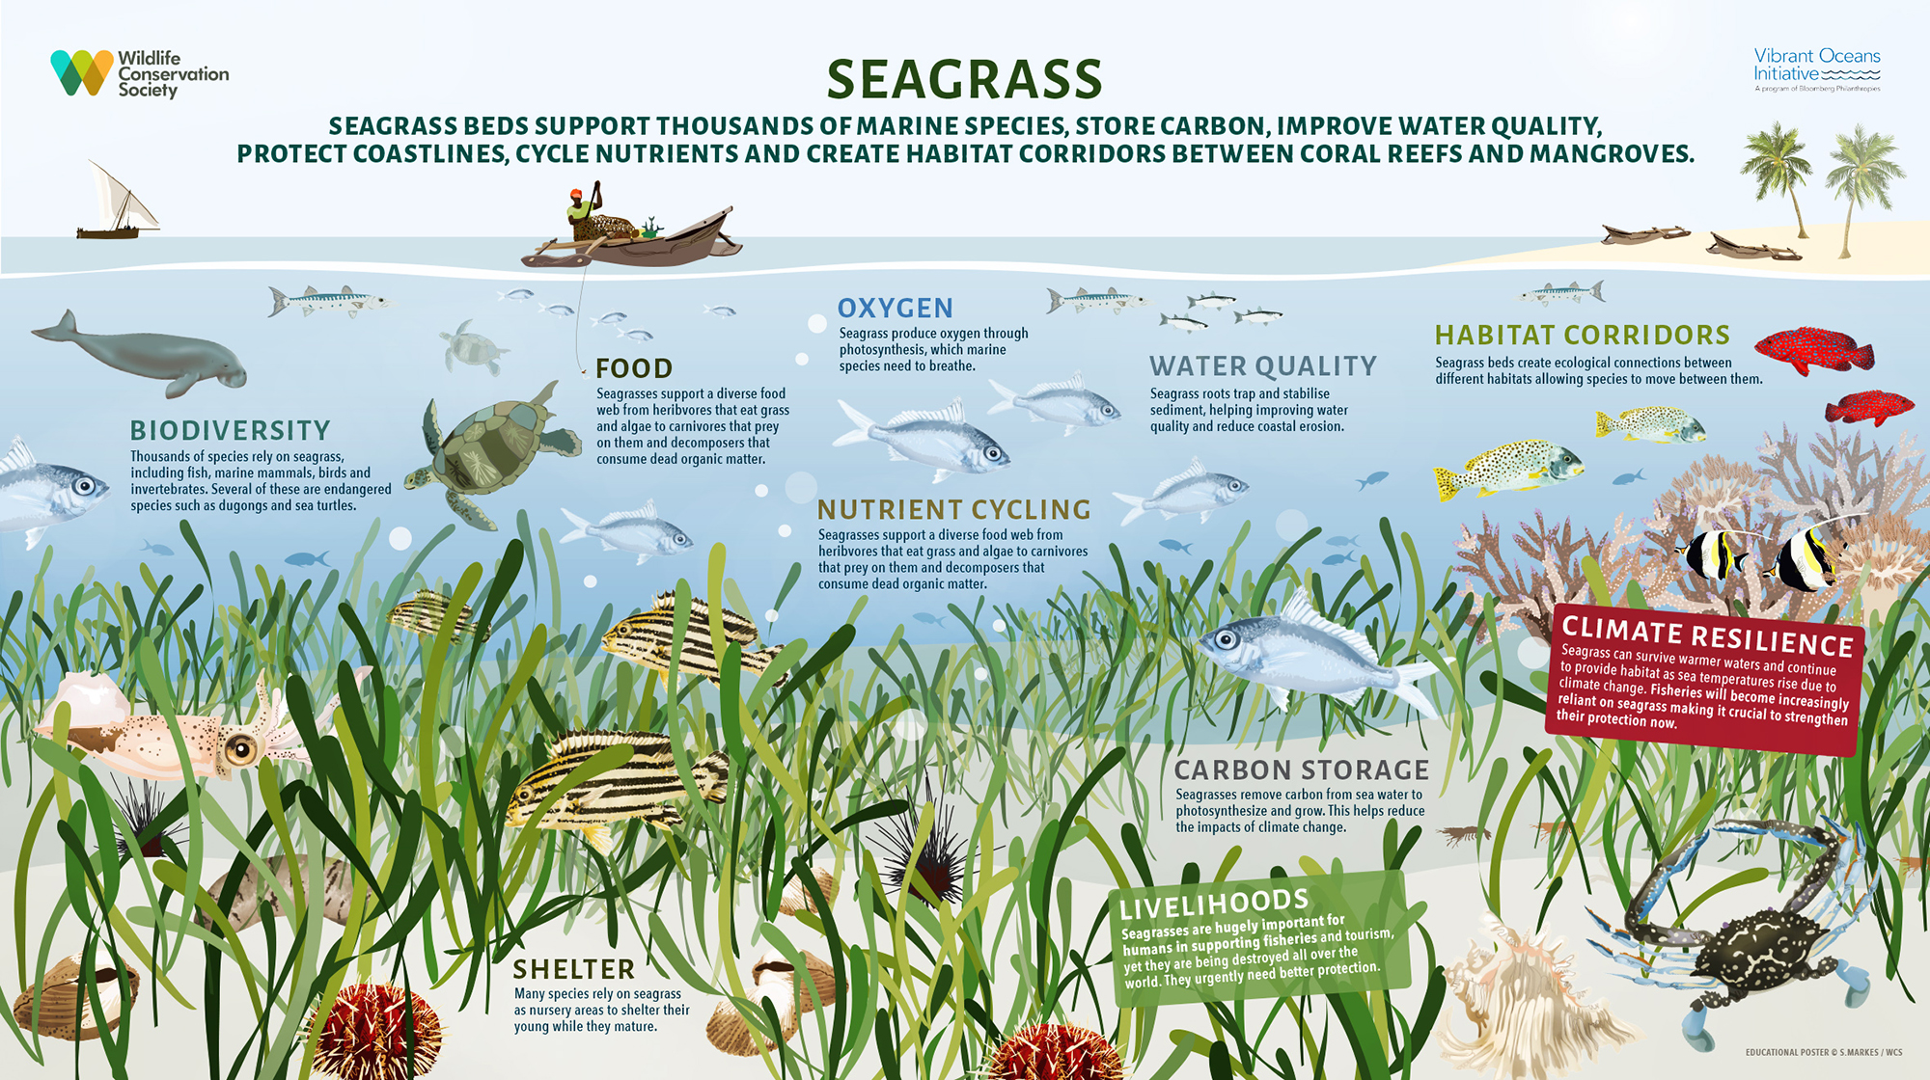

Slide 4
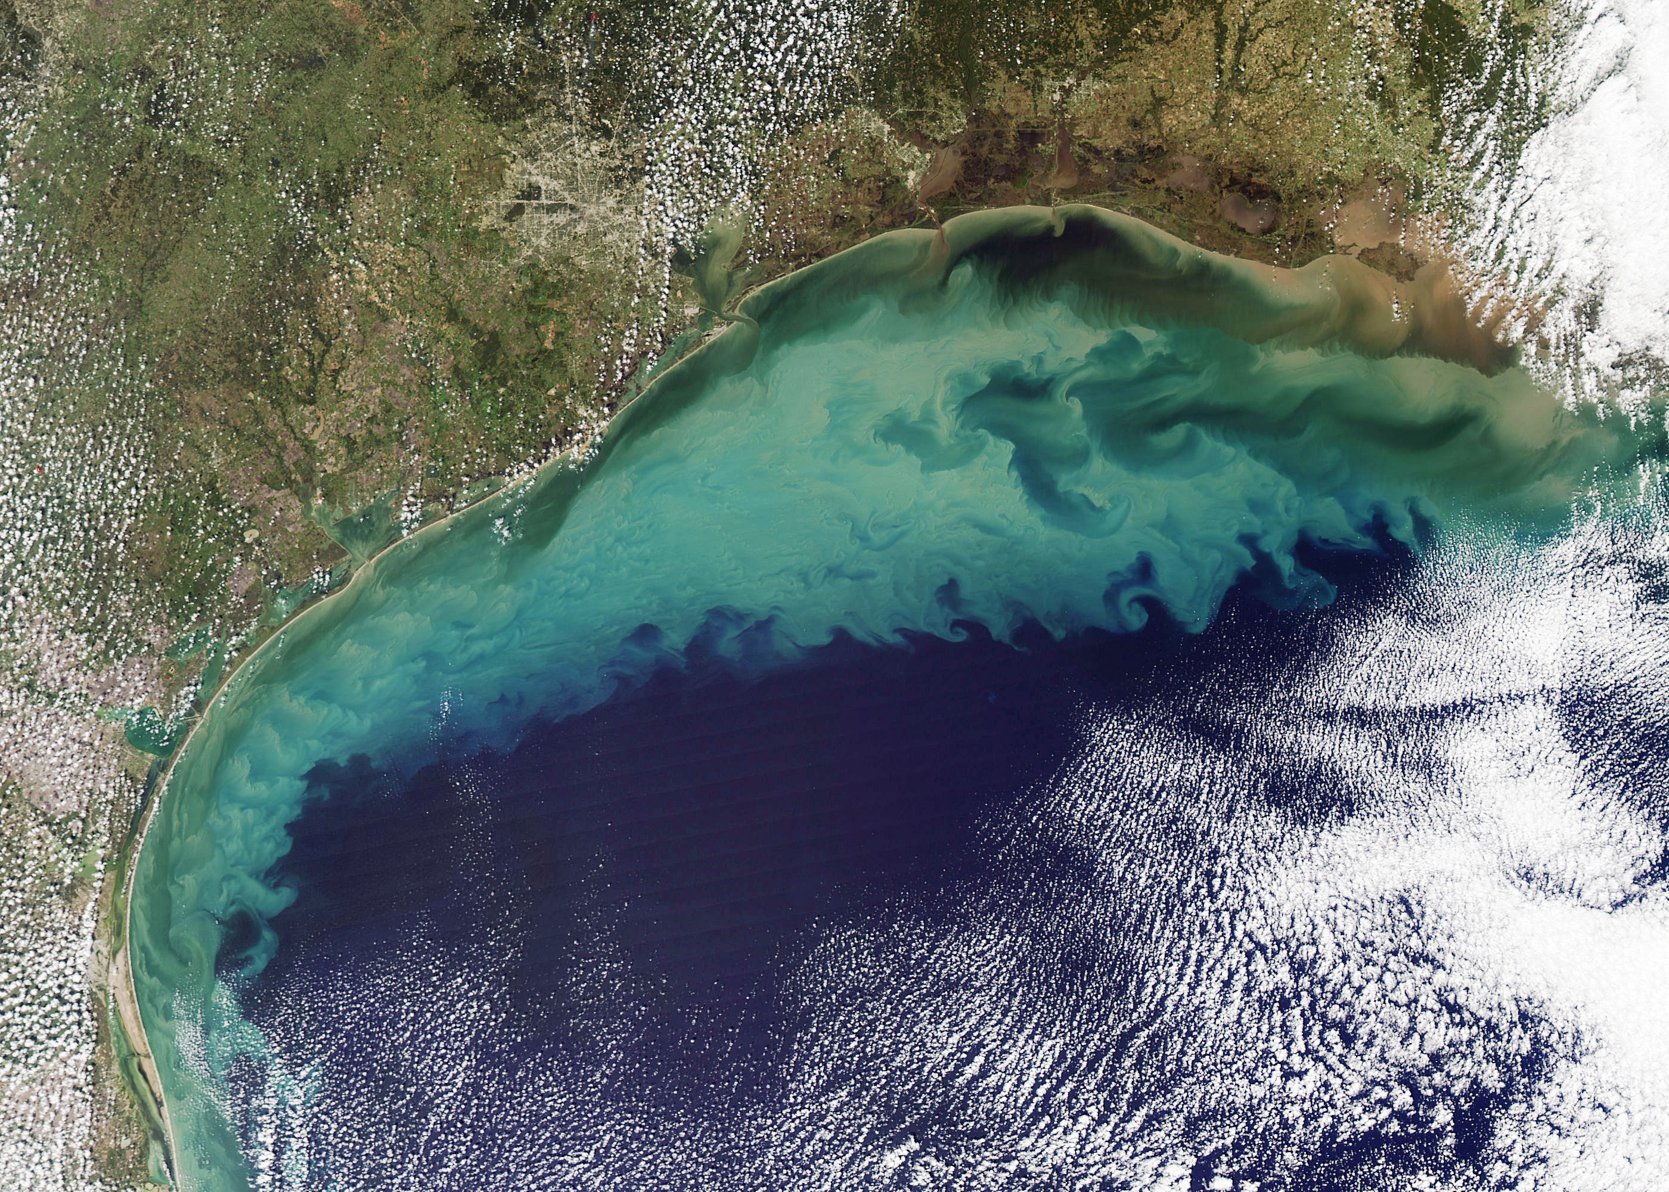
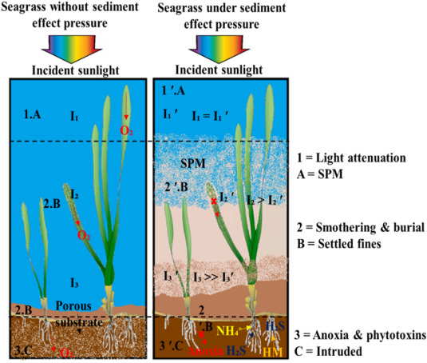
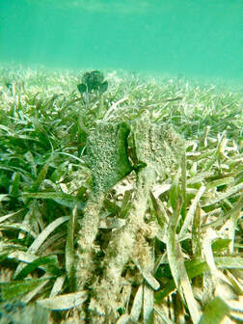
Sediment Plumes

Slide 5


CMP OYSTER MARICULTURE
Measure potential sediment generation at cultivated oyster mariculture (COM) operations in TX
Apply knowledge to simulate sediment plumes with similar characteristics at test seagrass beds, to measure if there were impacts to the seagrass.
Light Intensity parameter collected

Slide 6


Project Goals
Understand light intensity behavior on experimental sediment plumes
Tidy field data to be processed into RStudio
Manipulate data to visualize percent light attenuation
Compare percent light attenuation values through all experiments in an area through the development of a two-dimensional heatmap of percent light attenuation values

Slide 7
METHODS

Slide 8
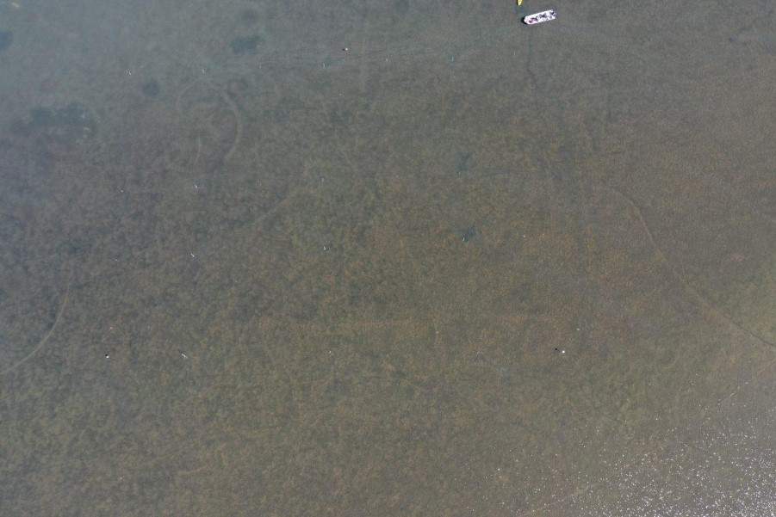
Study Site
(San Jose Island Map Picture here)
Notes:
The first Seagrass study site that was selected was located on the western side of San Jose Island Southeast from the Southern tip of Mud Island, near North Pass. Depth at this location varied by up to 14 cm across the entire plot (mean depth 40 cm). A study site map showing depths across the site is presented below. This site served as the seagrass study site with a sandy substrate. Halodule wrightii was the predominant species, spread in a uniform pattern and density across the entire experimental plot. The experimental plot was rotated to the Northeast with the baseline following the compass heading 30 degrees ~NE. This was done to match prevailing wind patterns in the area coming out of the Southeast. Weather forecasts and conditions for this site were obtained from using the Port Aransas (Inside) weather station on Willy weather.

Slide 9
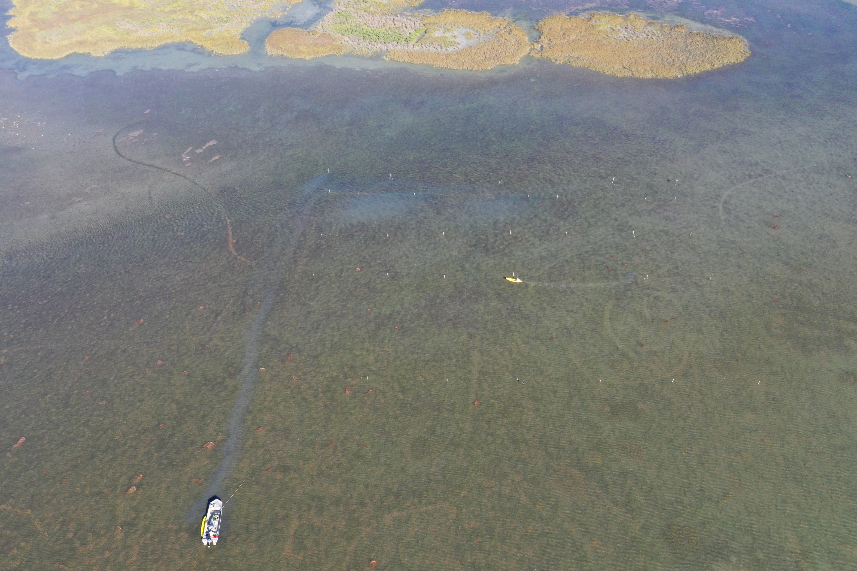
Experimental Design
Track 1
Track 2
Track 3
Grid Layout
Tracks
Zones
200 ft
Zone C
200 ft
100 ft
Zone B
50 ft
Zone A
300 ft

Slide 10
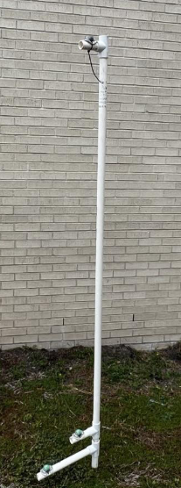
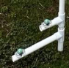
Light Logger Setup
Top Logger
Bottom Logger 10cm off the bottom
Loggers have individual serial numbers going permanently to a specific pole (A-L)
Separated in depth by 13cm
Notes:
Rebar placed inside PVC to hold upright
Peg inserted to lowest PVC to prevent turning due to currents

Slide 11
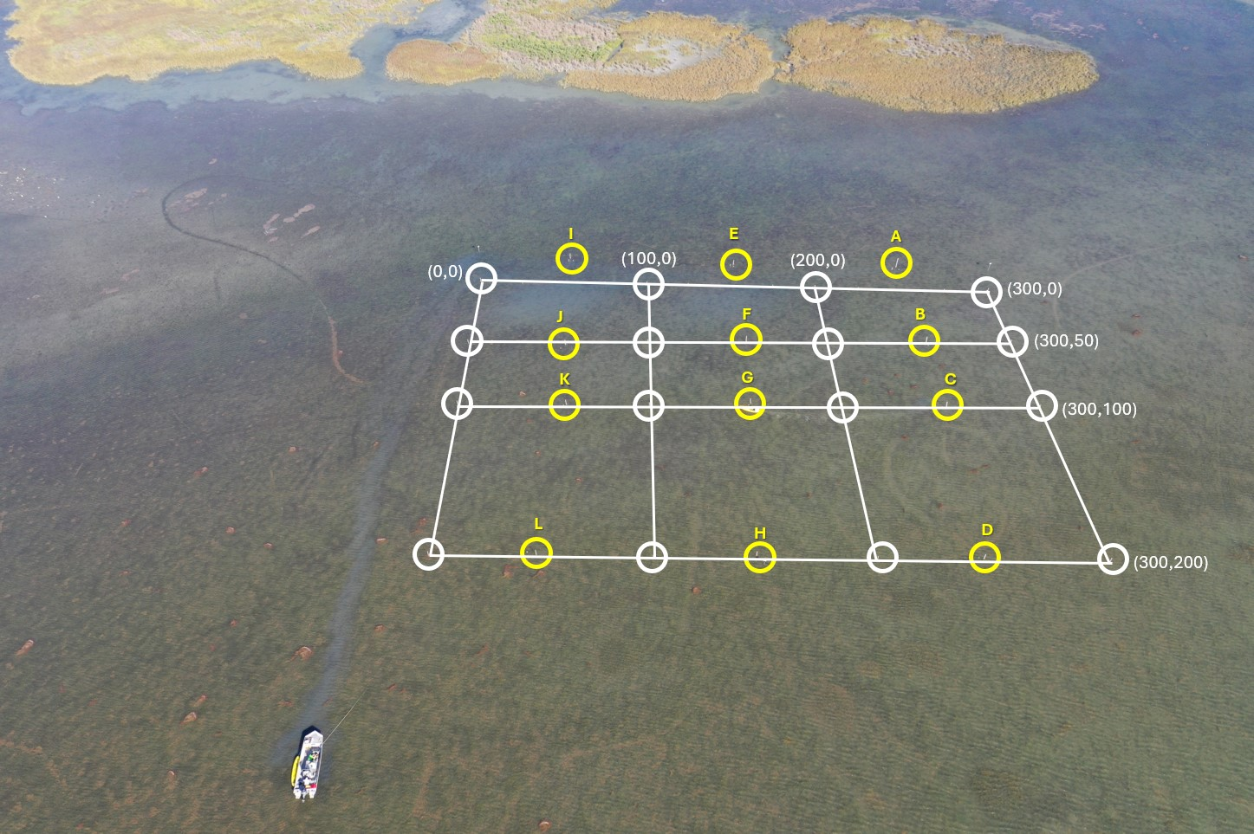
07-18-2022 Experimental Layout

Slide 12
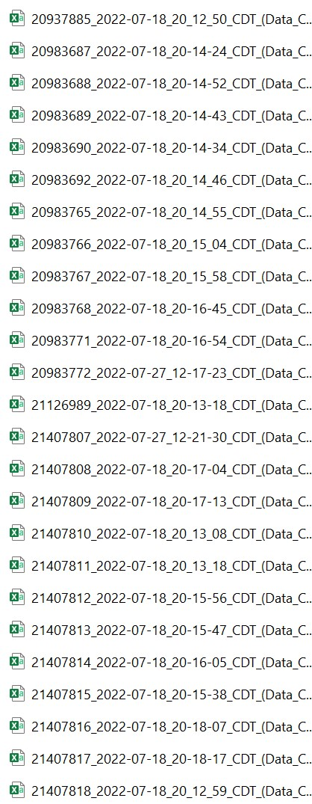
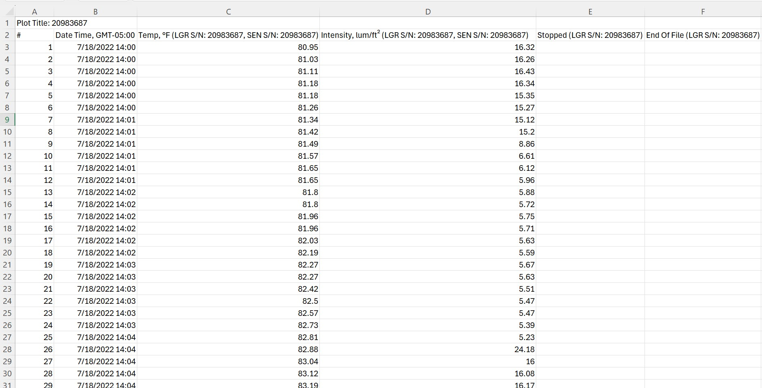
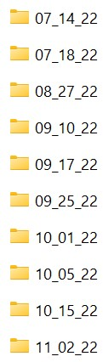
Raw Data Collected by Light Loggers

Slide 13
Experimental Design
(300,200)
(200,200)
(100,200)
(0,200)
Coordinate System
Inverse on x axis
(300,100)
(200,100)
(100,50)
(0,100)
(300,50)
(200,50)
(100,50)
(0,50)
(300,0)
(200,0)
(100,0)
(0,0)
Notes:
Facilitates defining light logger pole position

Slide 14
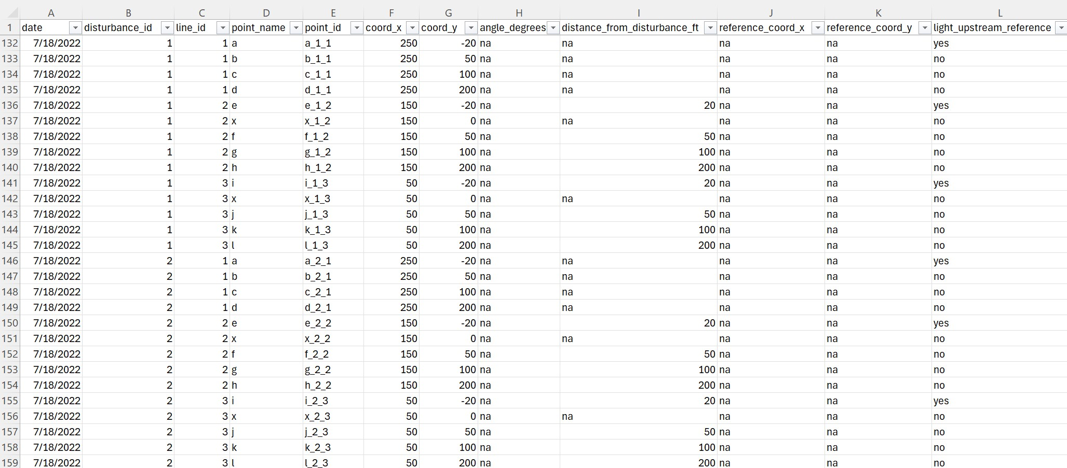
Tidying Up Data for RStudio

Slide 15
07-18-2022 Experimental Layout

Slide 16
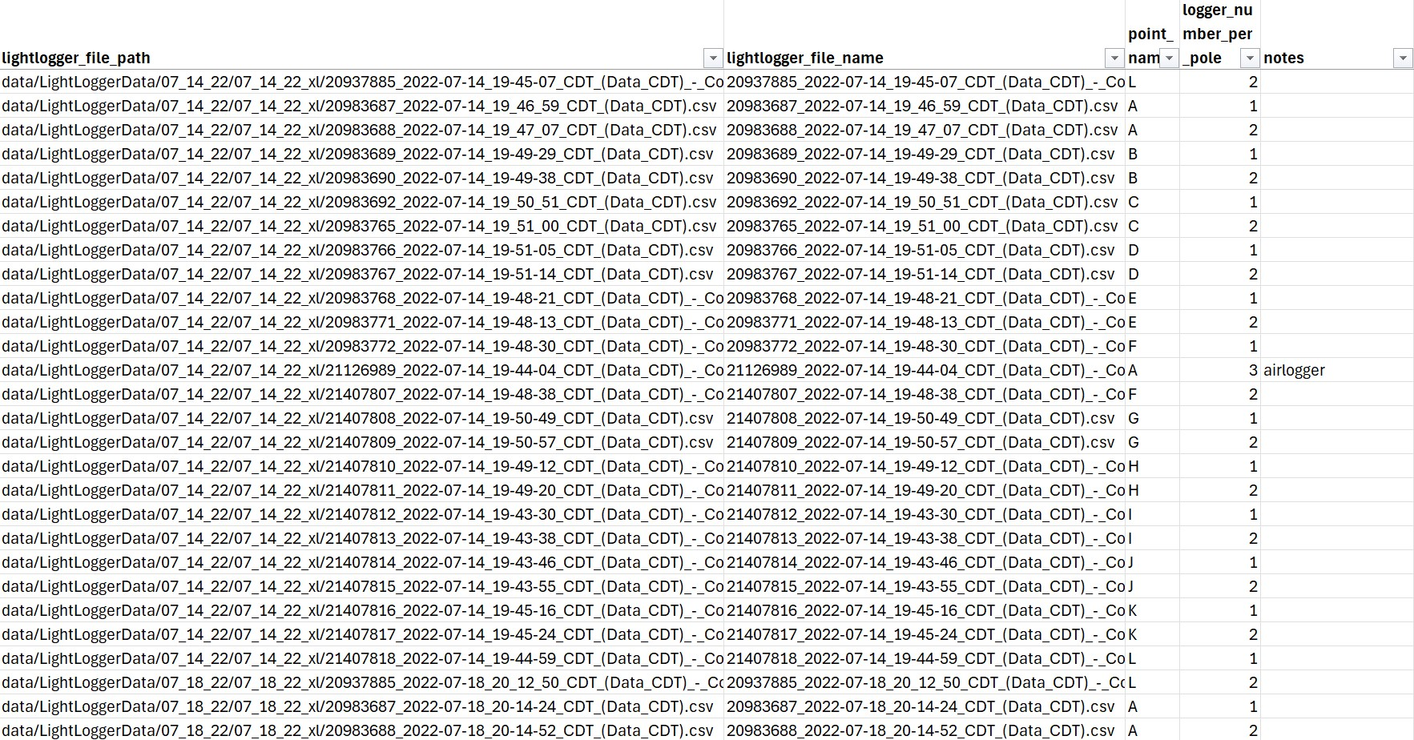
File Paths for Individual Light Loggers
pole_legend.xlxs – Sheet 1 (data_lightloggers)

Slide 17
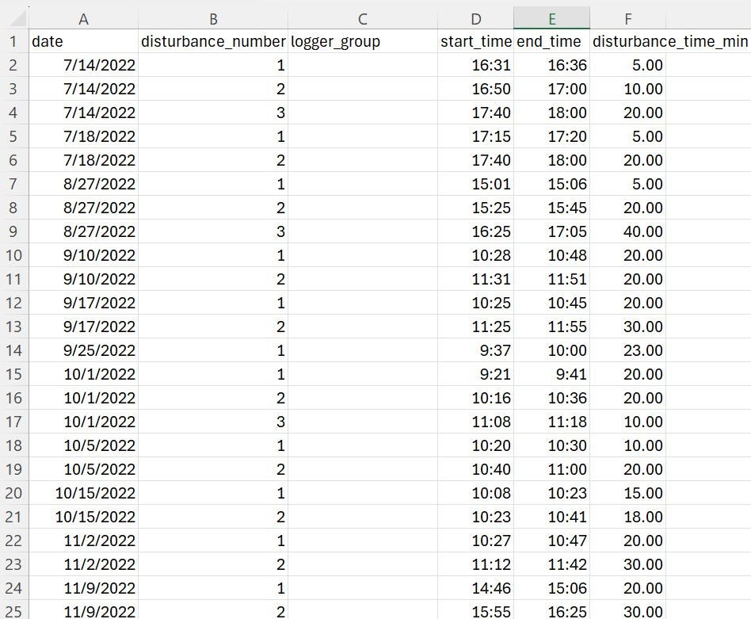
Disturbance Timeframes
pole_legend.xlxs – Sheet 2 (disturbance_periods)

Slide 18
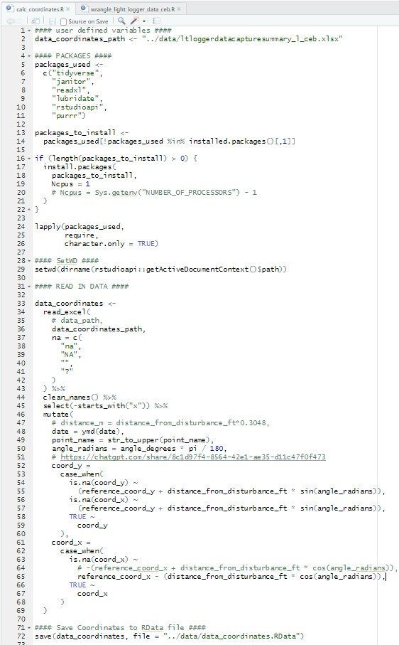
Data Manipulation – Calculating Coordinates

Slide 19
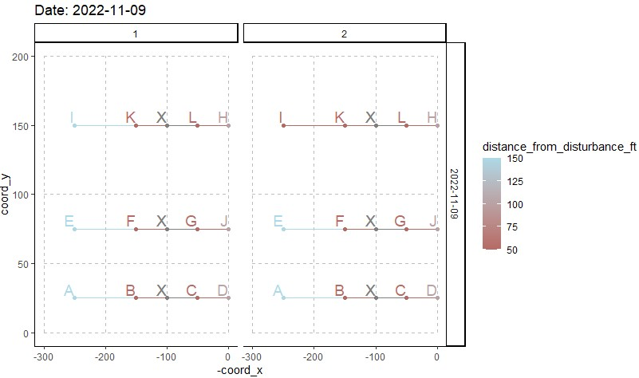
Data Manipulation – Calculating Coordinates
Notes:
Image of all maps at once

Slide 20
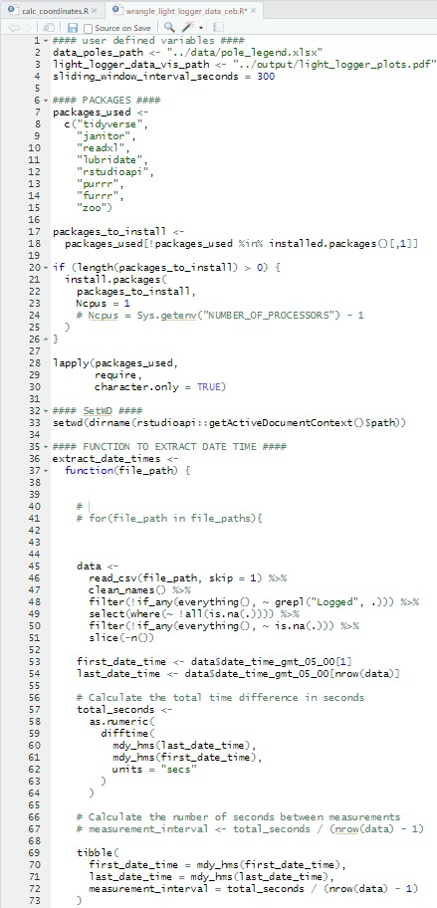
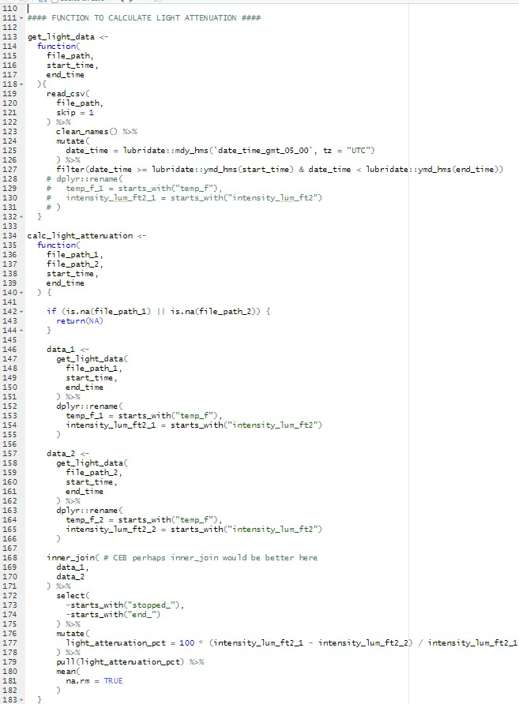
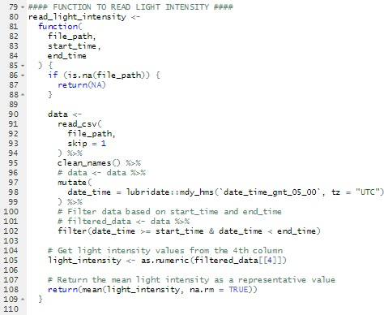
Data Manipulation – Percent Light Attenuation

Slide 21
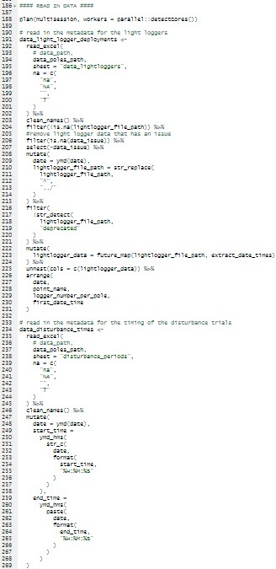
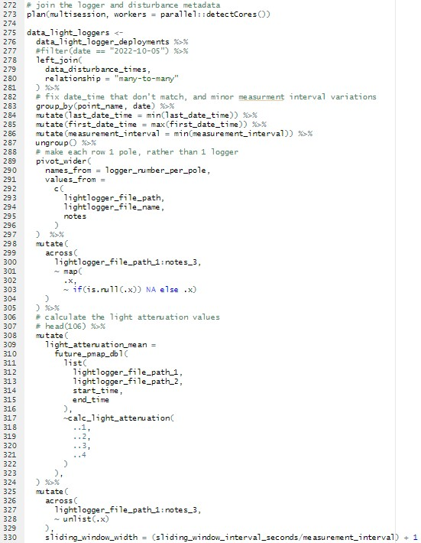
Data Manipulation – Percent Light Attenuation

Slide 22
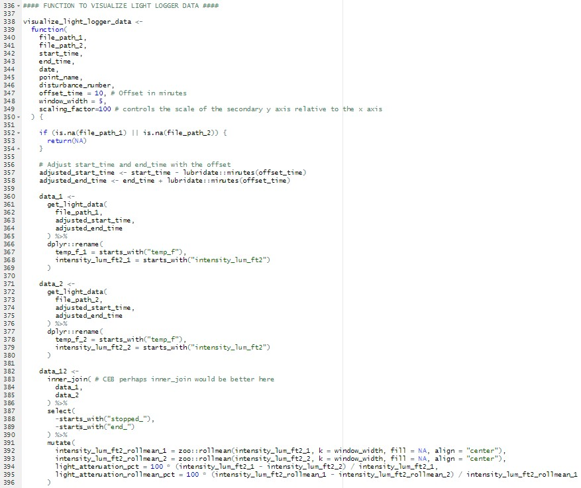
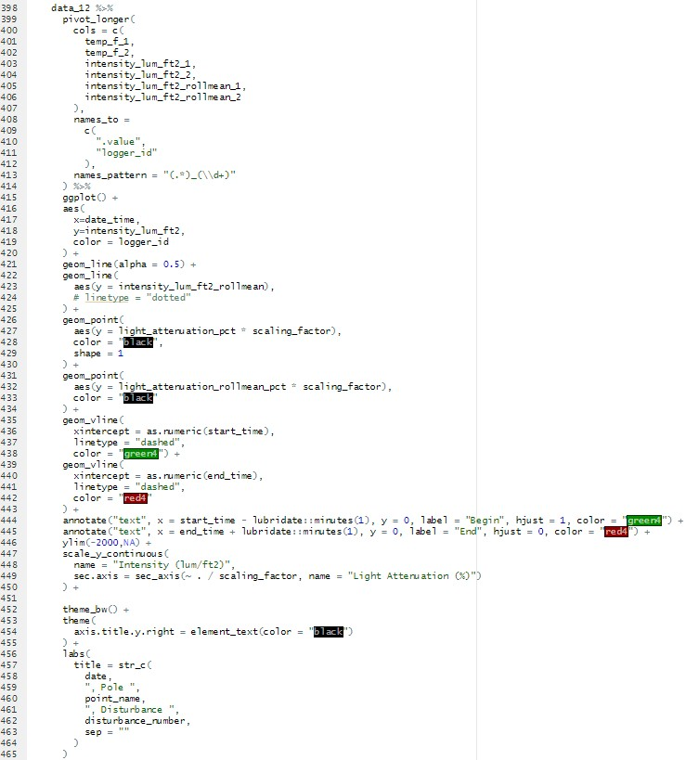
Data Manipulation – Percent Light Attenuation

Slide 23
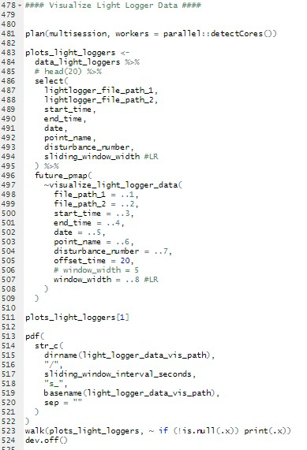
Data Manipulation – Percent Light Attenuation

Slide 24
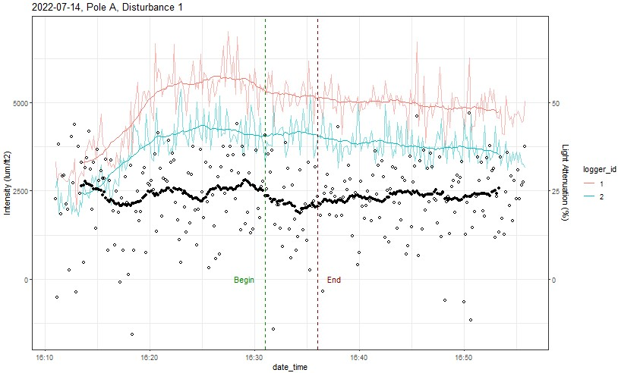
Data Manipulation – Percent Light Attenuation
Notes:
1 or various?

Slide 25
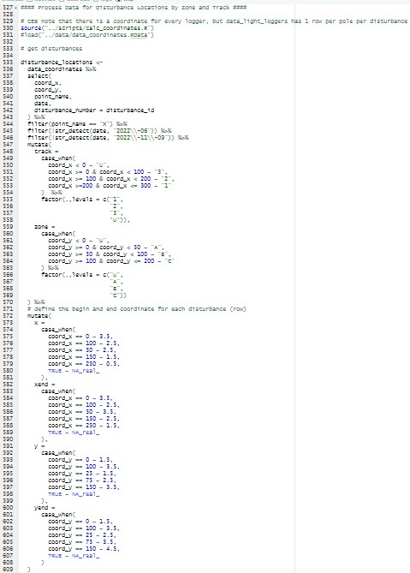
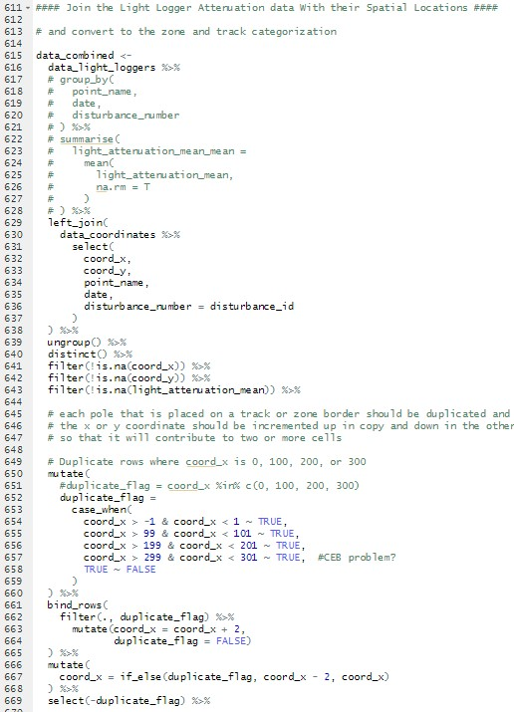
Data Manipulation – Individual Heatmaps

Slide 26
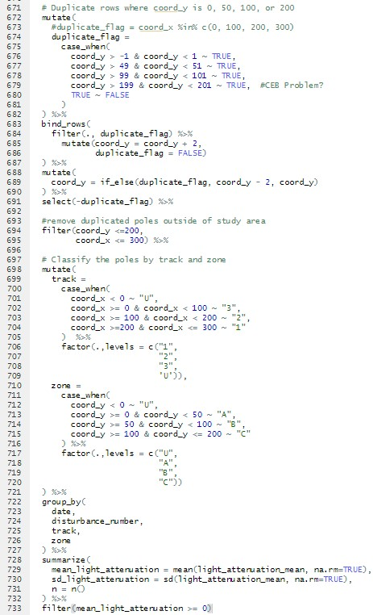
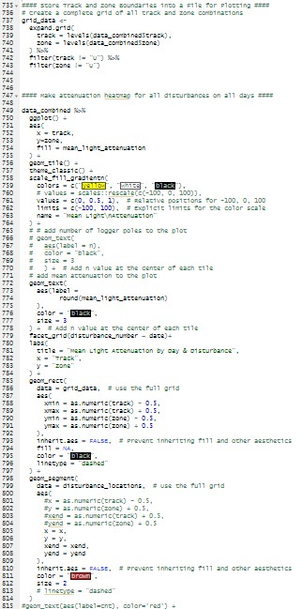
Data Manipulation – Individual Heatmaps

Slide 27
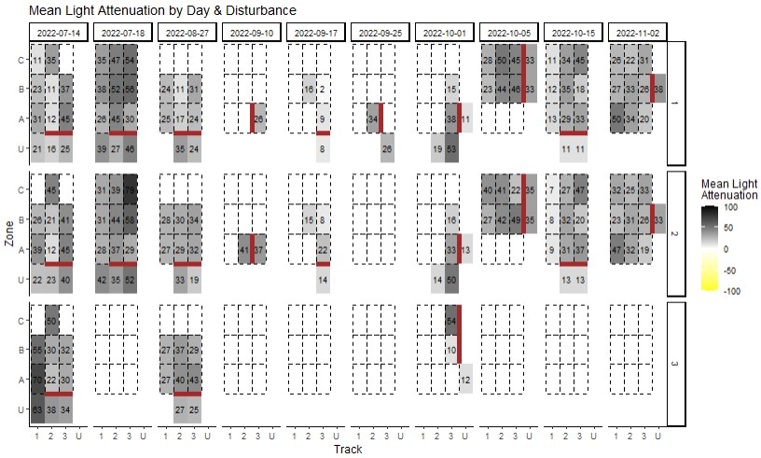
Data Manipulation – Individual Heatmaps

Slide 28
Data Manipulation – Compiled Heatmap
script

Slide 29
RESULTS

Slide 30
Compiled Heatmap

Slide 31
DISCUSSION

Slide 32
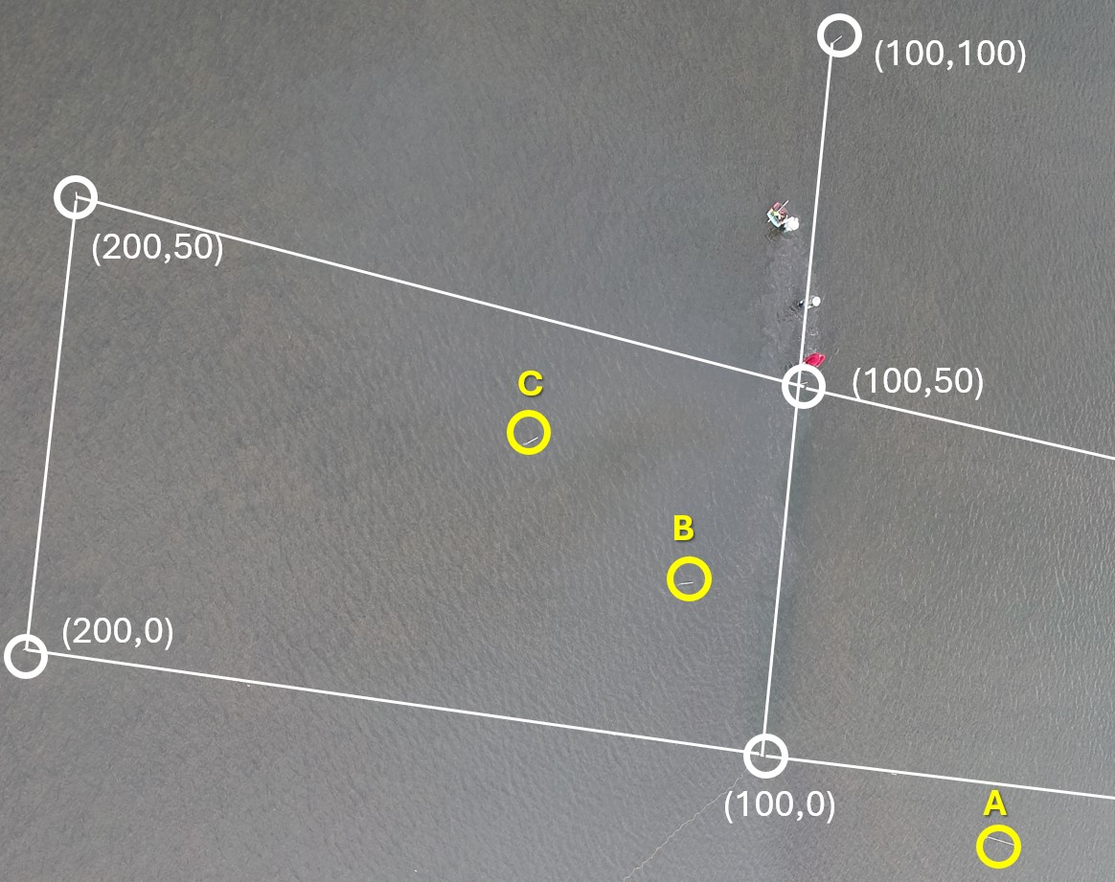
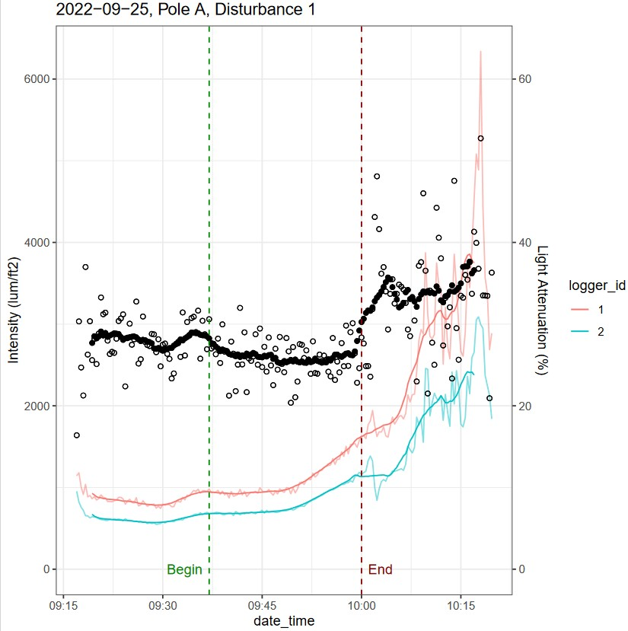
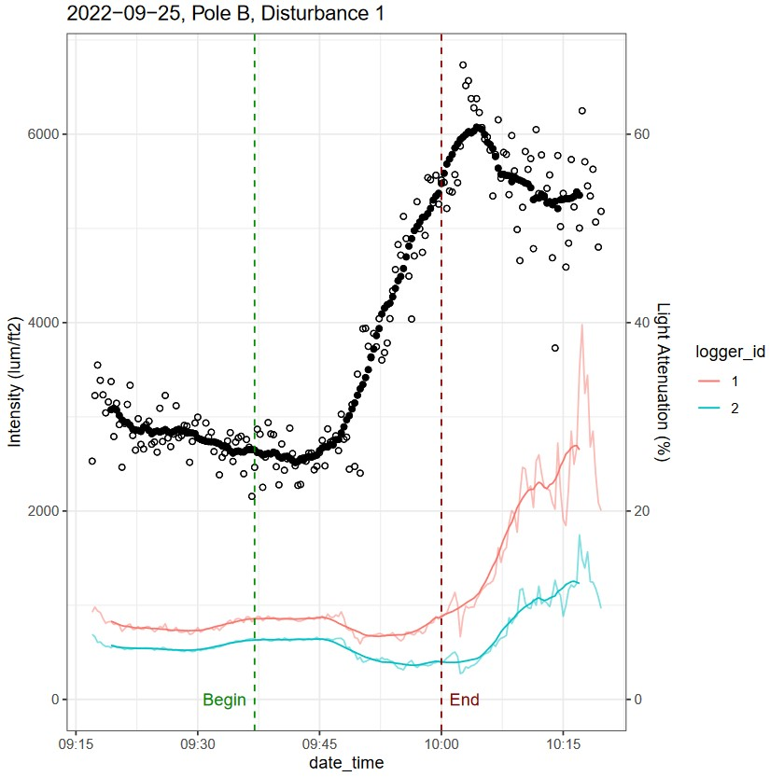
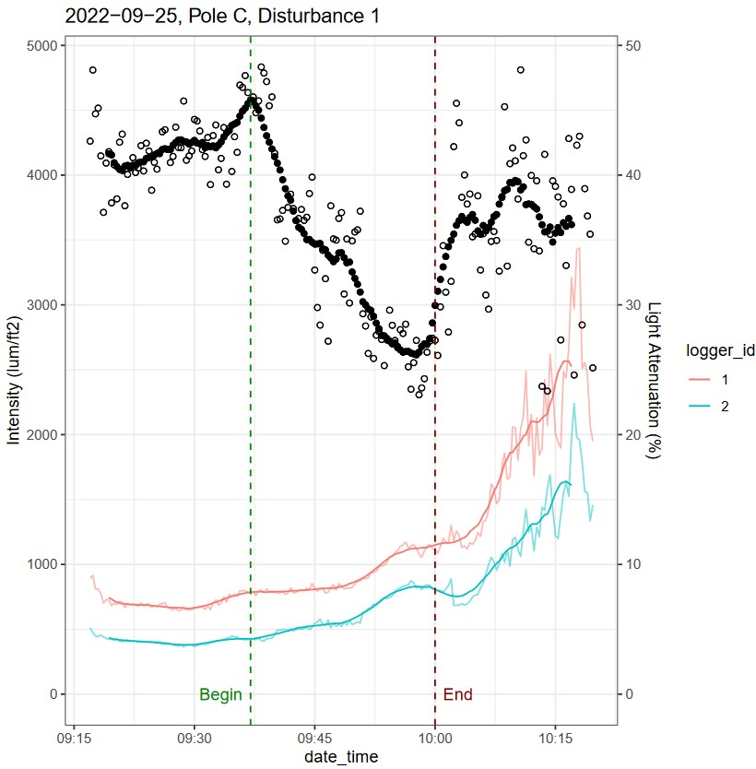
Light Attenuation Example 1
09-25-22 Disturbance 1 10:00 a.m.

Slide 33
Light Attenuation Example 2

Slide 34
Improvements
Dates with wrong information deleted
Net around disturbance area so floating debris does not cover light sensors

Slide 35
CONCLUSION

Slide 36
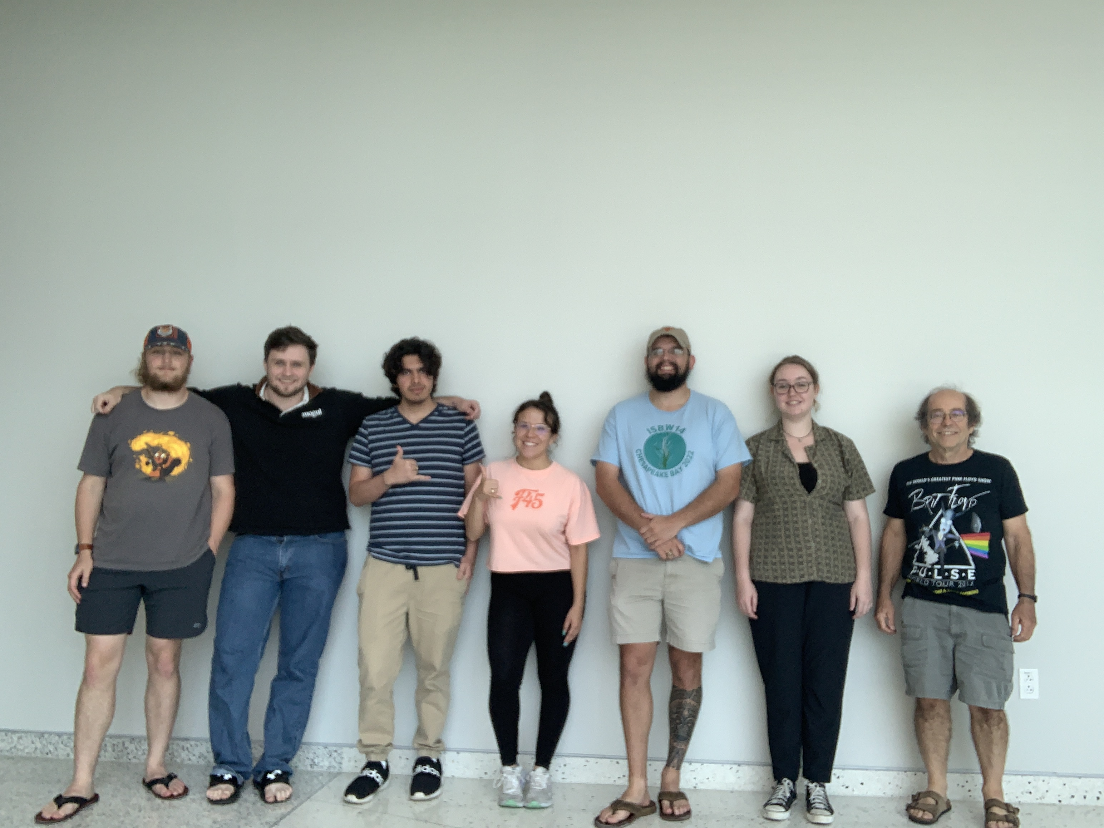
Lab Pictures

Slide 37
Works Cited

